Slide 1
Software Engineering :
2 : Software Engineering Process and Models
Professor Imed Bouchrika National School of Artificial Intelligence imed.bouchrika@ensia.edu.dz

Slide 2
Outline :
Software Process and Activities
Software Process Models
Traditional Methodologies
Waterfall
Incremental
Spiral
Prototyping
Agile Methodologies
XP
Scrum
Choosing a Process Model

Slide 3
Software Process and Activities
To develop a Software for the “Hello World”
Requirement Analysis : Understand the problem
Design : Perform some design and planning
Implementation : Code and Develop the Software
Testing : Validate, Verify and Test the software
Integration : Release, Install, Run, Integrate or Deploy the software for the client
Maintenance : Maintenance, Evolution and Support

Slide 4
Software Process and Activities
Ideal Process :
Design and Planning
Implementation & Development
Requirement Engineering
Maintenance
Testing
Integration

Slide 5
Software Process and Activities
Process in Reality :
Design and Planning
Implementation & Development
Requirement Engineering
Maintenance
Testing
Integration

Slide 6
Software Process and Activities
Process :
is a collection of activities, actions, and tasks that are performed during the development life cycle of the software product including the maintenance phase.
The process is composed of activities which
Can be decomposed into actions or deliverables which
are composed of tasks

Slide 7
Software Process and Activities
Process Activities :
Generic Activities in a Software Engineering Process:
Requirements Specification
Design and Planning
Coding/Implementation/Construction
Testing
Integration
Maintenance

Slide 8
Software Process and Activities
Process Activities : The following information needs to be defined :
Deliverable : The outcome of the activity, for example:
Architectural Design
Specification Documentation
Role : Reflects the responsibilities of the people involved in the activity
Condition ( Pre- or Post- ) : Statements or conditions before or after the activity. For example, the design Activity :
Pre-condition : Specification Requirements Activity must be completed
Post-condition : Architectural Designs must be reviewed by an Expert.

Slide 9
Software Process and Activities
Umbrella Activities :
Software engineering process framework activities are complemented by a number of umbrella activities including :
Software Project Management and Control
Technical Review and Inspection
Risk Management
Software Quality Assurance
Measurement and Metrics
…

Slide 10
Software Process and Activities
Activity Task :
It is a work unit with a specific purpose related to the larger goal defined within an activity or an action.
Tasks can be of different types, Examples of Tasks :
Implementation of new Functionality
Fix Bug of the system A
Buy some equipment
Negotiate a deal with a supplier
Send Invoices to Customer
Collect data from end-users
Hire a Translator
Setup Git Repository …

Slide 11
Software Process and Activities
Activity Task :
Task is usually assigned to a single employee at a time
Task can be reassigned to another employee ( even at different department)
The task can be moved from different activity phases depending on the organization of the company and the activity,
Example of possible activity phases :
To do → In Progress → Done
Idea/Backlog →To do → In progress → To Review →Completed → Delivered
Backlog →In Plan → Started →Completed → To Deliver → To Accept →Closed → Trash

Slide 12
Software Process and Activities
Activity Task : Phases
Backlog → New Ideas , New Features, Possible Bugs, any other tasks to do.
In Plan → Features/Tasks/Bugs that have been confirmed to be taken into consideration
Started → Tasks that employees have started to work on them.
Completed → Tasks where the employees claimed to have completed them provided that completion is reviewed by their manager.
To Deliver → The task/feature/bug fix is pending integration/release into the production system
To Accept → The task/feature/bug is pending acceptance by the client or task owner
Closed → The task is fully completed, delivered and accepted.
Trash → This task/feature/functionality is ignored

Slide 13
Software Process and Activities
Activity Task : Phases
Backlog → New Ideas , New Features, Possible Bugs, any other tasks to do.
In Plan → Features/Tasks/Bugs that have been confirmed to be taken into consideration
Started → Tasks that employees have started to work on them.
Completed → Tasks where the employees claimed to have completed them provided that completion is reviewed by their manager.
To Deliver → The task/feature/bug fix is pending integration/release into the production system
To Accept → The task/feature/bug is pending acceptance by the client or task owner
Closed → The task is fully completed, delivered and accepted.
Trash → This task/feature/functionality is ignored
You can have one generic workflow of phases for all activities Or Each activity can have its specific flow of phases

Slide 14
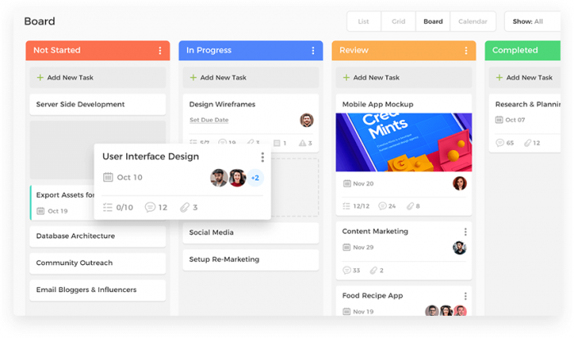
Software Process and Activities
Activity Task :
Kanban/Board View: Visual way to provide an insight about the tasks and at which stage of the workflow are at.

Slide 15
Software Process and Activities
Activity Task :
Policies for completing a Task.
A task is should never be marked completed by the staff executing the task
When the executor feels that the task is completed
They assign the task back to their manager or (N+1) informing them that the task is completed.
The manager would later decide either to mark it completed or re-assign the task to another employee to verify and check.

Slide 16
Software Process and Activities
Activity Task :
The complexity of tasks can differ and if necessary:
Sub-tasks can be created inside a given task to :
Distribute the load among other employees
Have better insight on the progress of the task

Slide 17
Software Process and Activities
Activity Task :
Due date : the project manager or the executor of the task must set a due date indicating when the task should be completed.
Task Duration : For better estimation of the project cost, the time spent on a task must be recorded on the employee timesheet.
Task Dependencies : There are tasks which rely on other tasks. Bad communication or improper prioritization can lead to the stagnation of the project.

Slide 18
Software Process Models
What’s a Process Model :
is a description of what activities/tasks need to be performed in what sequence under what conditions by whom to achieve the desired results
is an abstract representation of how a process is conducted in terms of structuring and ordering the tasks to develop the software product
The model describe the process flow

Slide 19
Software Process Models
What’s a Process Model :
It can be linear workflow
Activity 1
Activity 2
Activity 3
Activity 4

Slide 20
Software Process Models
What’s a Process Model :
Or iterative/cyclic workflow
Activity 1
Activity 2
Activity 4
Activity 3

Slide 21
Software Process Models
What’s a Process Model :
Or even parallel workflows
Activity 1
Activity 2
Activity 3
Activity 4
Activity 1’
Activity 2’
Activity 3’
Activity 4’
Combine
Activity 1’’
Activity 2’’
Activity 3’’
Activity 4’’

Slide 22
Software Process Models
Why a software process model :
is to provide guidance for systematically coordinating and controlling the tasks that must be performed in order to achieve the end product and the project objective ( = Be organized )
What if the development is done by one person ? do we still need a adopt a process model ?

Slide 23
Software Process Models
Why a software process model :
is to provide guidance for systematically coordinating and controlling the tasks that must be performed in order to achieve the end product and the project objective
What if the development is done by one person ? do we still need a adopt a process model ?
There is a disagreement about the need to use a specific process model for a one-man team but : It is always recommended to adopt a process model for keeping yourself organized and keep the growing list of tasks/features/bugs under control.

Slide 24
Software Process Models
Why a software process model :
Software product needs to be of high quality
The quality and productivity achieved in a software project depends on the process framework used for executing the project

Slide 25
Software Process Models
Types of Process Models
Plan-Driven Processes :
are processes where all of the process activities are planned in advance and progress is measured against this plan

Slide 26
Software Process Models
Types of Process Models
Agile Processes :
Planning is incremental and it is easier to change the process to reflect changing customer requirements.

Slide 27
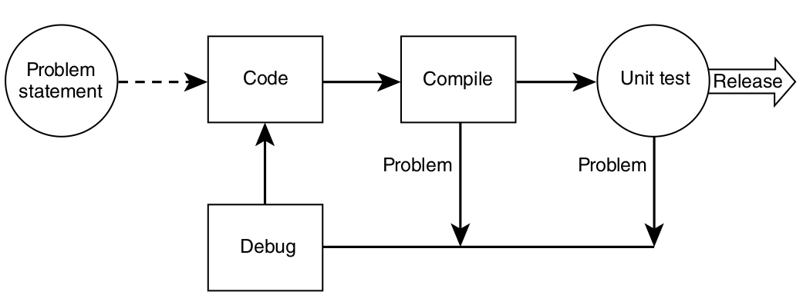
Software Process Models: Simplest Process Model
Code-and-Fix Model :
No specification or design are made, developers would aim to focus heavily on the coding aspect
Anytime, there is an error or a functionality to be implemented, the developers will intervene the fix the error or do further coding.
It is rare that the documentation are produced

Slide 28
Software Process Models: Simplest Process Model
Code-and-Fix Model :
No specification or design are made, developers would aim to focus heavily on the coding aspect
Anytime, there is an error or a functionality to be implemented, the developers will intervene the fix the error or do further coding.
It is rare that the documentation are produced
Who does the testing ?

Slide 29
Software Process Models: Simplest Process Model
Code-and-Fix Model :
No specification or design are made, developers would aim to focus heavily on the coding aspect
Anytime, there is an error or a functionality to be implemented, the developers will intervene the fix the error or do further coding.
It is rare that the documentation are produced
The developers themselves do the testing because :
There is no documentation or specification to tell the testers about the software, its functionalities, problem to be solved…

Slide 30
Software Process Models: Simplest Process Model
Code-and-Fix Model :
As
software products are becoming more complex
Increasing number of tasks with changing requirements
More people are involved
This model would not be a fit to most large software projects
Software is not maintainable
Higher costs
Quality is questionable

Slide 31
Software Process Models: Traditional Methodologies
Requirement Analysis
Waterfall Model :
Design and Planning
Implementation
Testing
Integration
Maintenance

Slide 32
Software Process Models: Traditional Methodologies
Waterfall Model :
Move from one phase to the next only when its preceding phase is completed and perfected
The output from each stage is fed into the next stage in sequence.
US department of defence projects attempted to entrench this model by requiring their contractors to produce the waterfall deliverables and then to formally accept them to a certain schedule (US military standard DoD-2167)

Slide 33
Software Process Models: Traditional Methodologies
Waterfall Model :
Strength :
Works for well-understood problems
Forces the software team to complete requirements before design, design before code…
It is easy to manage due to the rigidity of the model – each phase has specific deliverables and a review process.
It can protect the company from the risk of diving into never ending requirements and changes.

Slide 34
Software Process Models: Traditional Methodologies
Waterfall Model :
Weakness :
Does not allow for changing requirements
Does not work for novel or poorly understood problems
Lack of user involvement once specification is written
Unrealistic separation of specification from design
There are debates on the possibility to get back from design to specification
Doesn’t easily accommodate prototyping, reuse ..
No working software is produced until late during the life cycle.

Slide 35
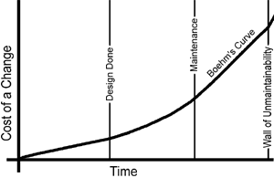
Software Process Models: Traditional Methodologies
Waterfall Model :
Barry Boehm’ Cost of Change (1981) :
Software Engineering Economics
Data from waterfall-­based projects in 1970s at IBM

Slide 36
Software Process Models: Traditional Methodologies
Waterfall Model :
When to use it :
Embedded systems : Because of the inflexibility of hardware, The software’s functionality must be therefore specified clearly to accommodate the hardware without the unpredictability to change.
Critical systems where there is a need for extensive safety and security analysis of the software specification and design. Safety-related problems in the specification and design are usually very expensive to correct at the implementation stage.
Large software systems that are part of broader engineering systems developed by several partner companies.

Slide 37
Software Process Models: Traditional Methodologies
Waterfall Model :
When not to use it :
The waterfall model is not the right process model in situations where :
Software requirements change quickly.
Informal communication among teams/members/customer
Iterative development and agile methods are better for these systems

Slide 38
Software Process Models: Traditional Methodologies
Waterfall Model :
Classical Waterfall :
No going back to a previous activities.
Iterative Waterfall Model :
You can go back to earlier Activities by providing Feedback Path
Requirement Analysis
Design and Planning
Implementation
Testing
Integration
Maintenance

Slide 39
Software Process Models: Traditional Methodologies
Incremental Process Model:
Requirement Engineering
Requirement Analysis for Part A
Design and Planning for A
Requirement Analysis for Part B
Design and Planning for B
Implementation of A
Requirement Analysis for Part C
Test Build A
Maintenance
Implementation of B
Design and Planning for C
Integration A
Test Build B
Implementation of C
Integration B
Full System
Test Build C
Integration C

Slide 40
Software Process Models: Traditional Methodologies
Incremental Process Model:
Requirements of the Full Software are first broken down into several modules/Subsystems/Set of Functionalities that can be incrementally constructed and delivered consecutively
Initially : The Development Team ensures the development of core features of the system as the first release.
Once the core features are fully developed, then new modules/functionalities are added in Successive versions.
Each incremental version is usually developed using an iterative waterfall model of development.

Slide 41
Software Process Models: Traditional Methodologies
Incremental Process Model:
Strength
Uses divide and conquer for a breakdown of tasks and complexity reduction.
Clients have a clear idea of the project with constant feedback from the client at each release
Incremental Resource Deployment.
Weakness
Because of its continuous iterations the cost increases.
Lack of an overall vision for the long term plan
Potential risk to break a production system

Slide 42
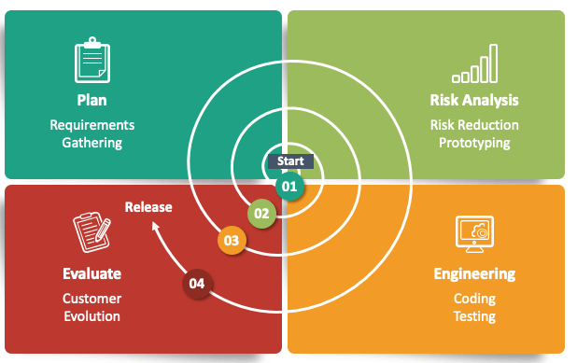
Software Process Models: Traditional Methodologies
Spiral Process Model:
Start by planning,..

Slide 43
Software Process Models: Traditional Methodologies
Spiral Process Model:
is a risk-driven model where the focus is on managing risk through multiple iterations of the software development process.
There are many iteration where each iteration of the spiral has four activities which represents a complete software development cycle, from requirements gathering and analysis to design, implementation, testing, and maintenance.

Slide 44
Software Process Models: Traditional Methodologies
Spiral Process Model:
The main activities/four quadrants within each spiral iteration are :
Planning : Requirements are gathered from the customers and the objectives are identified. Then alternative solutions possible for the phase are proposed in this quadrant. Previous evaluation feedback can be utilized for the planning.
Risk Analysis : Identify and resolve Risks based on analysing the proposed solutions. At the end of this activity, the Prototype is built for the best possible solution.
Engineering : The identified features are developed and verified through testing. At the end of the third quadrant, the next version of the software is released to the customer.
Evaluate : the Customers evaluate the released version of the software.

Slide 45
Software Process Models: Traditional Methodologies
Maintenance
Integration
Prototyping Process Model:
Build Prototype
Testing
Requirement Analysis
Quick Design
Prototype Evaluation
Implementation
Review and Update

Slide 46
Software Process Models: Traditional Methodologies
Prototyping Process Model:
Prototyping is the process to produce a replica of the software product with minimal efforts and quickly.
The prototype should exhibit the main functionality to be engineered. Though, it can be a non-functional system without any business logic
The aim is to quickly create or build a prototype to clarify the requirements.
The clients can therefore express clearly their needs by having something similar to the product they are expecting.

Slide 47
Software Process Models: Traditional Methodologies
Prototyping Process Model:
Prototyping is an iterative process requiring designing, building , feedback, refining.
Once the requirements are fully understood, the customer is happy with the prototype
The prototype is disregarded as it does not meet the quality standards
The full system is built and implemented based on the prototype

Slide 48
Software Process Models: Traditional Methodologies
Prototyping Process Model:
Prototyping Tools:
Mockups ( Pen and Papers, or even software tools)
Online tools:
Figma, Balsamiq, proto.io ,,,
Visual Tools (Widgets with Drag and Drop) for rapid application development.

Slide 49
Software Process Models: Traditional Methodologies
Prototyping Process Model:
Strength
Better way to get the requirements correctly
Weakness
Can be costly to build throwaway prototypes + time consuming
Bad Perception/Appreciation about the effort/pricing of the final product:
Too fast to be build the prototype → to build the software product, must be quick too.

Slide 50
Software Process Models: Traditional Methodologies
No Code Process Model:
Aims to develop software products using “Drag and Drop” Platforms offering pre-built components to conduct various types of business logic.
Existing Tools/Platforms :
Bubble
Visual Programming Languages
With or Against ?
Scalability ?
Custom Business Logic ?
Sovereignty ?

Slide 51
Software Process Models: Traditional Methodologies
Other Process Models for Software Engineering:
Rapid Application Development
V Model
…

Slide 52
Software Process Models: Traditional Methodologies
Major Drawbacks of Traditional Methodologies
Lengthy development times:
Inability to cope with changing requirements
Too much reliance on heroic developer effort
Waste/duplication of effort ( Example .. Much documentation is mandated, including documentation that may or may not be needed)

Slide 53
Software Process Models: Agile Methodologies
What’s Agile
Agile processes are a family of software development methodologies that produce software in short iterations and allow for greater changes in design.
Although there is no absolute definition about what constitutes an Agile method, there are several characteristics shared by most Agile methods
The philosophy behind agile methods is reflected in the agile manifesto ( http://agilemanifesto.org) issued by the leading developers of these methods

